Slide 1
Inheritance
Course Code: CSC 2210
Course Title: Object Oriented Programming 2
Dept. of Computer Science
Faculty of Science and Technology
Lecturer No: | 04 | Week No: | 04 | Semester: | Fall 2023-2024
Lecturer: | Noboranjan Dey; noboranjan@aiub.edu

Slide 2
Topics
Inheritance
HAS-A relationship
IS-A relationship
Single
Multilevel
Hierarchical Inheritance

Slide 3
Inheritance
Inheritance is ability for derived class to inherit all the members of the base class
Derived class also can be referred to as “child class” or “subclass”
Base class also can be referred to as “parent class” or “superclass”
Syntax to specify inheritance
class SubClass : SuperClass
Inheritance allows to implement Specialization and Generalization concepts e.g.:
Radio button is-a specialized case of Control
Control is a base class
Radio button derived class

Slide 4


Slide 7
What is Inheritance?
A relationship between a more general class (called the superclass or base class) and a more specialised class(called the subclass or derived class).
For example, a Cat is a specific type of Animal. Therefore the Animal class could be the superclass/base class, and the Cat class could be a subclass of Animal.

Slide 8
Why is Inheritance important?
Inheritance is a fundamental concept in Object-Oriented programming.
Many objects exist that share a lot of commonality between them. By using inheritance, subclasses “inherit” the public variables and methods of the superclass, in addition to their own variables and methods.
Any private method or variables from the superclass will not be inherited.
Inheritance helps to improve code re-use and minimise duplicate code among related classes.

Slide 9
Inheritance Hierarchies
We can represent inheritance among objects via an inheritance hierarchy.
Vehicle
Motorbike
Car
Truck
Saloon
MPV

Slide 10
IS-A Relationship
Use the IS-A test to verify that your inheritance hierarchy is valid.
A Dog IS-A Animal – makes sense, therefore the Dog class can inherit from an Animal class.
A Door IS-A Car– doesn’t make sense, so the Door class shouldn’t inherit from the Car class.
An Animal IS-A Dog – doesn’t make sense. A Dog IS-A Animal, but an Animal is not a Dog.
The IS-A test only works in one direction i.e. a Cat IS-A Animal, but an Animal is not a Cat.

Slide 11
HAS-A Relationships
Use the HAS-A test to verify whether an object should contain another object as an instance variable. This is called object composition.
A Car IS-A Engine – doesn’t make sense.
A Car HAS-A Engine – This makes sense. So therefore our Car class would have an instance variable of type Engine.
public class Car{
private Engine carEngine;
public Car(){
carEngine = new Engine();
}
}

Slide 12
Inheritance in C#
public class Cat : Animal
{
public Cat() : base()
{
Console.WriteLine("Cat Constructor");
}
public void runUpATree()
{
Console.WriteLine("I am sleeping");
}
}
To declare a subclass in C#, we use the following notation
public class Subclass : BaseClass
We give the subclass a name followed by a colon (:) and the name of the base class we want to inherit from.

Slide 13
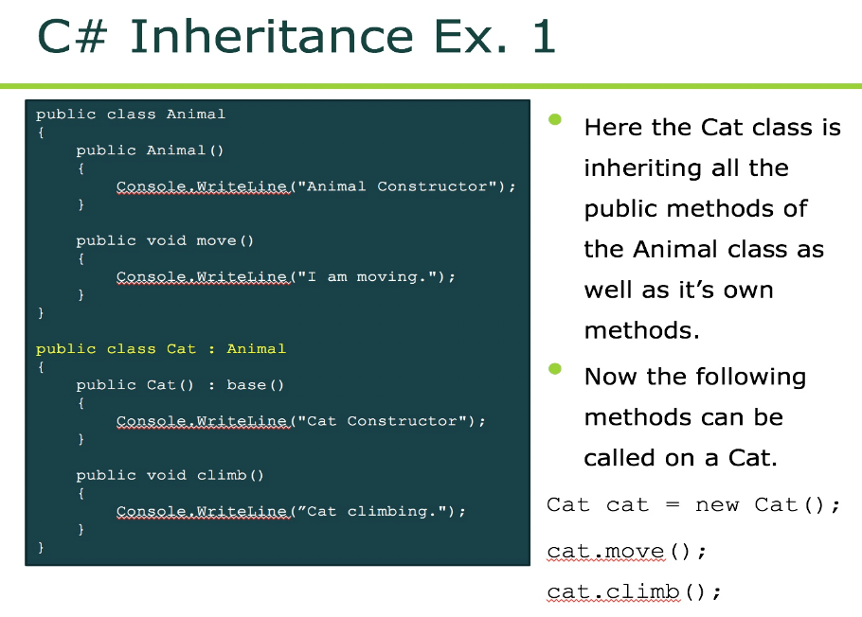

Slide 14
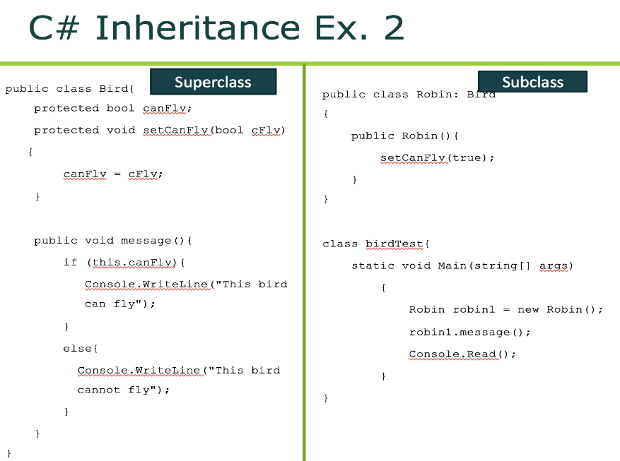

Slide 15
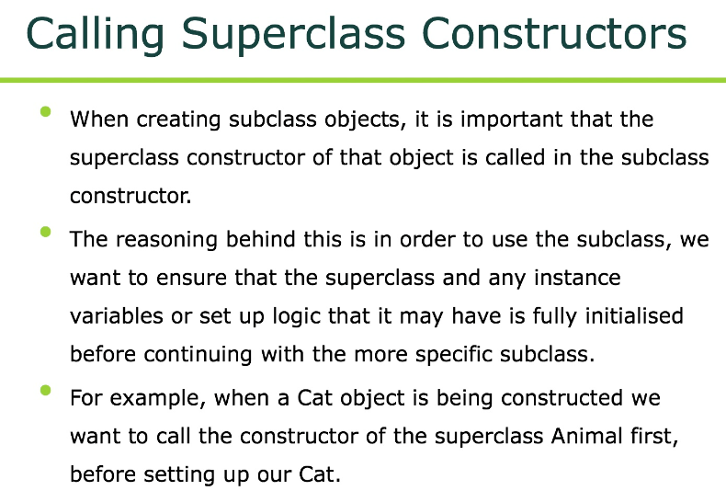

Slide 16
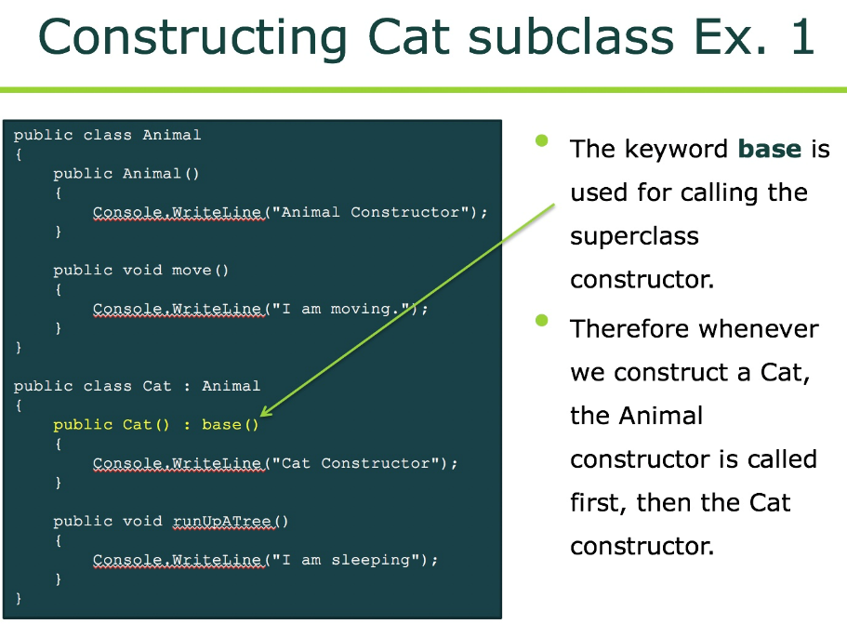

Slide 17
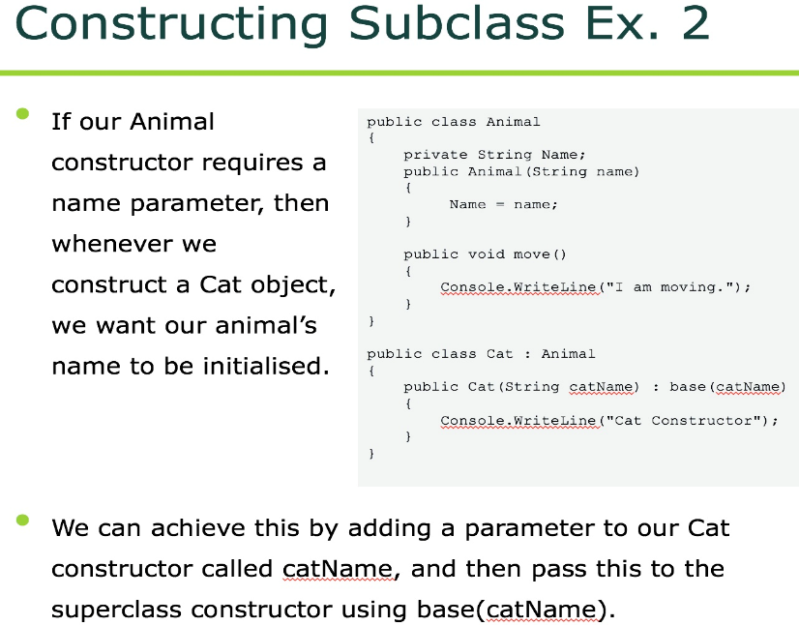

Slide 18
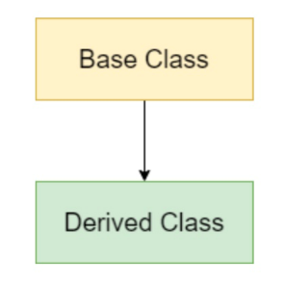
Single Inheritance
In this type of inheritance, the derived class inherits properties and behavior from a single base class. It's like a child inherits the traits of his/her parents.

Slide 19
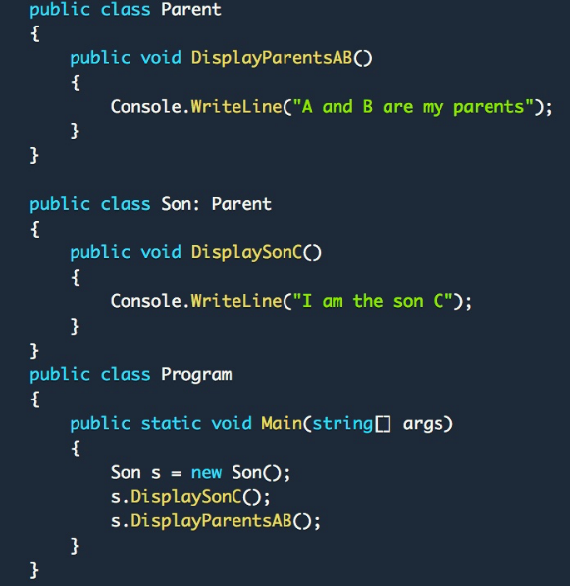

Single Inheritance
Output:

Slide 20
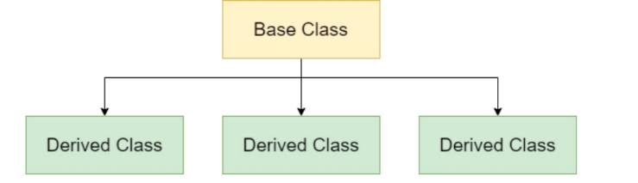
Hierarchical Inheritance
In this type of inheritance, the multiple classes derives from one base class. It's like having multiple kids, all inheriting traits from parent, but in their own different ways.

Slide 21
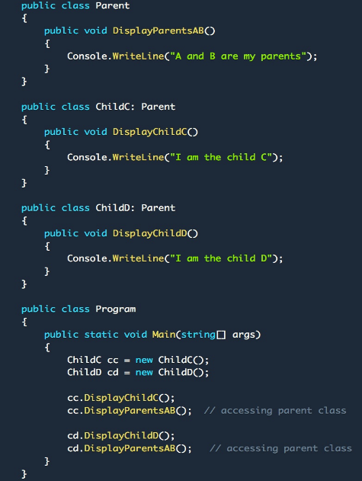
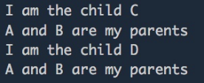
Output:

Slide 22
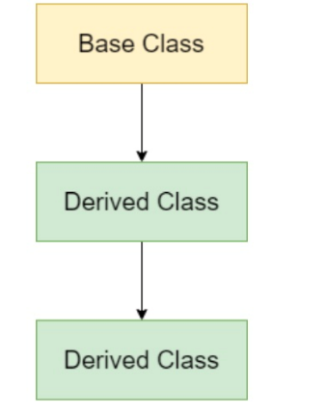
Multilevel Inheritance
In this type of inheritance, a class inherits another derived/child class which in turn inherits another class. It's like a child inherits the traits of his/her parents, and parents inherit the traits of their grandparents.

Slide 23
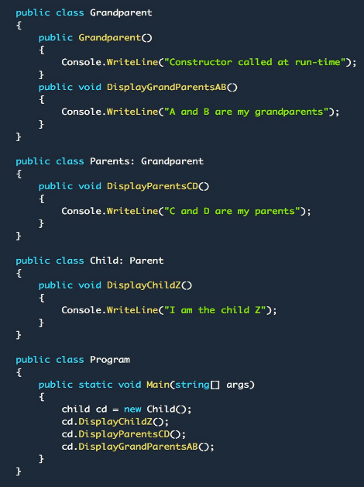

Output:

Slide 24

Thank You

Slide 25
Books
C# 4.0 The Complete Reference; Herbert Schildt; McGraw-Hill Osborne Media; 2010
Head First C# by Andrew Stellman
Fundamentals of Computer Programming with CSharp – Nakov v2013

Slide 26
References
MSDN Library; URL: http://msdn.microsoft.com/library
C# Language Specification; URL: http://download.microsoft.com/download/0/B/D/0BDA894F-
2CCD-4C2C-B5A7-4EB1171962E5/CSharp%20Language%20Specixfication.doc
C# 4.0 The Complete Reference; Herbert Schildt; McGraw-Hill Osborne Media; 2010

